Slide 1
Insurance Customer Response Prediction
By:Dhanush P

Slide 2
Introduction
In today’s competitive insurance industry, identifying customers who are most likely to respond to policy offers is a critical challenge. Traditional mass marketing approaches often lead to high operational costs and low conversion rates due to poor customer targeting.
This project focuses on building a machine learning–based predictive system that analyzes customer demographic and policy-related information to accurately predict whether a customer will respond positively to an insurance policy offer. By leveraging historical data and advanced classification algorithms, the solution aims to help insurance companies optimize marketing strategies, improve customer engagement, and increase policy sales efficiency.
The project demonstrates the end-to-end machine learning workflow, including data exploration, preprocessing, model training, evaluation, and deployment insights,

Slide 3
Objectives
To analyze historical insurance customer data and understand key factors influencing customer response to policy offers.
To perform data preprocessing and feature engineering to prepare high-quality input data for machine learning models.
To develop and compare multiple classification models such as Logistic Regression, Decision Tree, and Random Forest to predict customer response.
To evaluate model performance using standard metrics including Accuracy, Precision, Recall, F1-Score, and ROC-AUC.
To identify the best-performing model and justify its selection based on predictive performance and business relevance.
To demonstrate how predictive analytics can support targeted marketing, cost reduction, and improved policy conversion rates in the insurance domain.

Slide 4
About the Dataset
The dataset contains historical records of insurance customers along with their demographic and policy-related information.
Each record represents an individual customer and includes attributes such as age, gender, vehicle details, premium amount, and previous insurance history.
The target variable Response indicates whether a customer showed interest in the insurance policy (1 – Yes, 0 – No).
The dataset includes both categorical and numerical features, making it suitable for applying various machine learning classification techniques.
This data is used to identify patterns in customer behavior and build predictive models for insurance policy response.

Slide 5
EDA
Exploratory Data Analysis (EDA) is a crucial step in the machine learning pipeline that focuses on understanding the structure, patterns, and characteristics of the dataset before model building. In this project, EDA is used to analyze customer demographic and policy-related features to identify key factors influencing customer response to insurance policy offers.
Through statistical analysis and data visualization, EDA helps uncover relationships between variables, detect trends, identify imbalances, and gain business-oriented insights. The findings from EDA guide feature selection, preprocessing strategies, and model selection, ensuring that the predictive models are both accurate and interpretable.

Slide 6
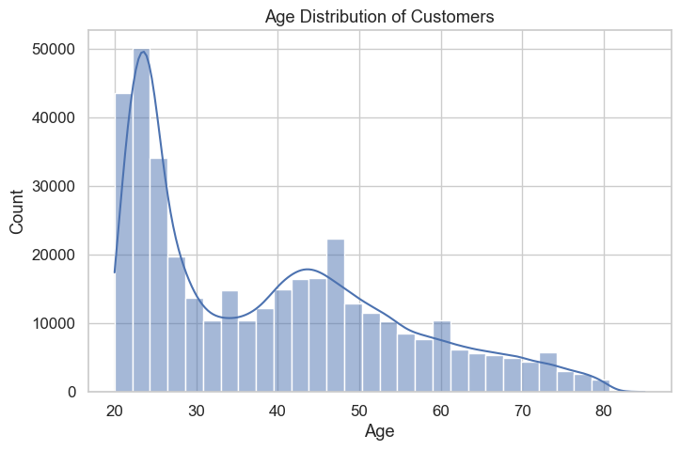
Age Distribution of Customers
Customers belong to different age groups.
Most customers are from the middle-age group.
Fewer customers are very young or very old.
Middle-aged customers show more interest in insurance.
Age helps in identifying the target customer group.

Slide 7
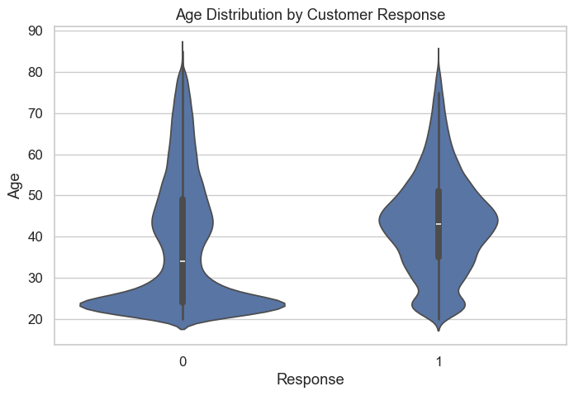
Age vs Customer Response
Customer responses vary across different age groups.
Middle-aged customers show a higher response rate compared to younger and older customers.
Younger customers tend to respond less, possibly due to lower risk perception.
Older customers also show lower response, which may be influenced by existing insurance coverage.
Age is an important factor in identifying potential target customers for insurance policies.

Slide 8
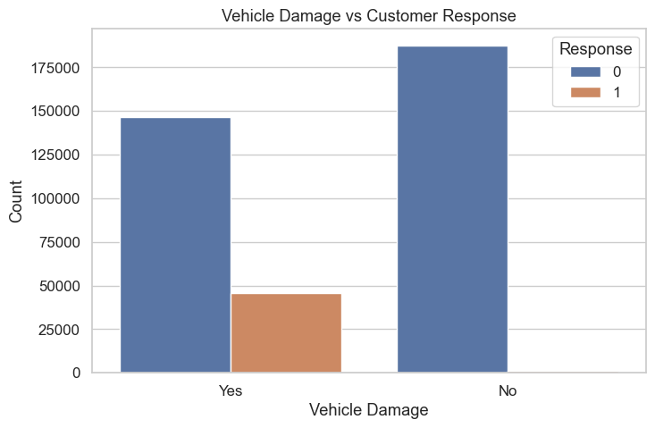
Vehicle Damage vs Customer Response
Customer response differs based on vehicle damage history.
Customers whose vehicles had previous damage show a higher response rate.
Customers without vehicle damage are less likely to respond.
Vehicle damage increases awareness of risk and insurance need.
Vehicle damage is a strong influencing factor in customer response.

Slide 9
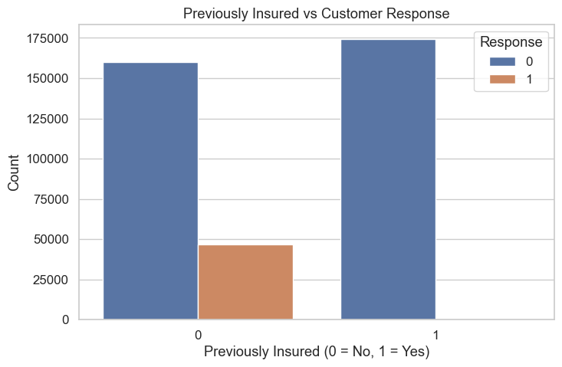
Previously Insured vs Customer Response
Customer response varies based on previous insurance status.
Customers who were not previously insured show a higher response rate.
Previously insured customers are less likely to respond to new offers.
Previous insurance status is a strong predictor of customer response.
This feature helps in identifying new customer acquisition opportunities.

Slide 10
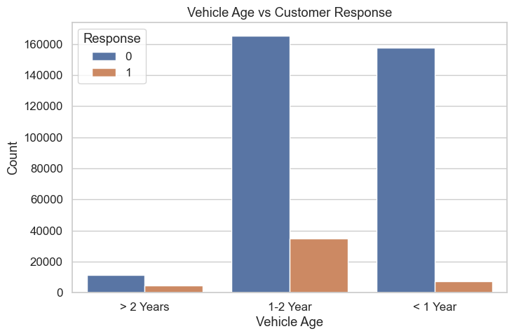
Vehicle Age vs Customer Response
Customer response changes with the age of the vehicle.
Owners of new and mid-age vehicles show higher response rates.
Very old vehicle owners respond less frequently.
Vehicle age reflects usage and risk level.
Vehicle age helps in targeted policy marketing.

Slide 11
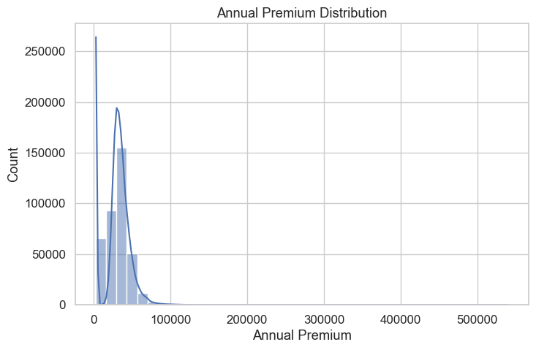
Annual Premium Distribution
Annual premium values vary widely across customers.
Most customers pay low to moderate premium amounts.
The distribution is right-skewed, with fewer high-premium customers.
Premium distribution helps understand customer affordability.
Useful for pricing strategy and segmentation.

Slide 12
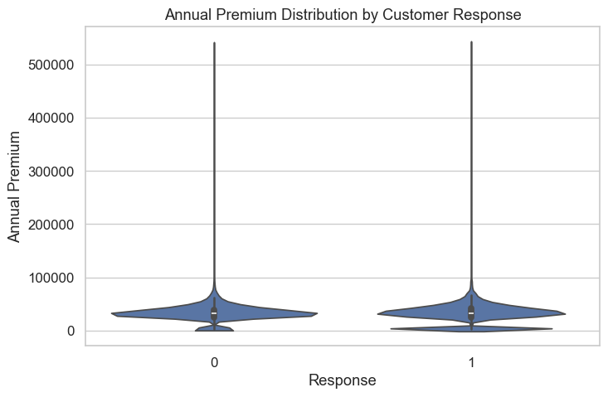
Annual Premium vs Customer Response
Customer response differs across premium ranges.
Responding customers tend to have moderate to higher premiums.
Very low premium customers show lower response rates.
Premium amount influences customer interest.
Important for premium-based targeting strategies.

Slide 13
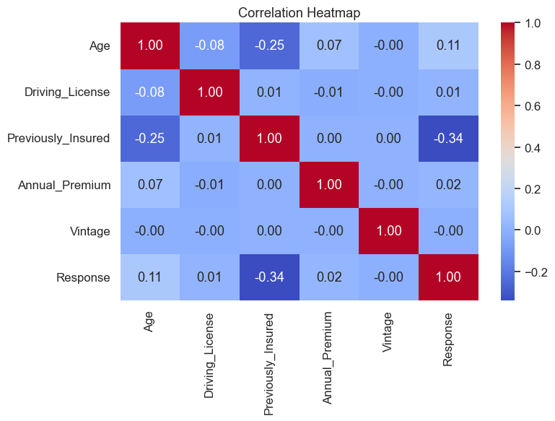
Correlation Heatmap
The heatmap shows relationships between numerical features.
Most features have weak to moderate correlation with the target.
No strong multicollinearity is observed among features.
Some features show positive correlation with customer response.
Helps in feature selection and model stability.

Slide 14
Data Preprocessing
Removed unnecessary or non-informative columns to improve model efficiency.
Checked for missing values and confirmed that the dataset contains no significant missing data.
Converted categorical variables such as Gender, Vehicle Age, and Vehicle Damage into numerical format using encoding techniques.
Ensured binary features like Driving License and Previously Insured were in the correct numerical format.
Scaled numerical features such as Age, Annual Premium, and Vintage to maintain uniform feature contribution.
Separated the dataset into features (X) and target variable (Response).
Split the data into training and testing sets to evaluate model performance.
Prepared the final cleaned dataset for machine learning model training.

Slide 15
Train–Test Split
After preprocessing, the dataset was divided into training and testing sets.
The training set was used to train machine learning models and learn patterns from the data.
The testing set was used to evaluate model performance on unseen data.
A standard train–test split ratio (e.g., 80% training and 20% testing) was applied.
The split ensures fair evaluation and helps detect overfitting.
The target variable Response was kept separate during the split process.

Slide 16
Model Selection
The problem is formulated as a binary classification task, where the goal is to predict customer response (Yes/No).
Multiple machine learning algorithms were selected to compare performance and robustness.
Logistic Regression was chosen as a baseline model due to its simplicity and interpretability.
Decision Tree Classifier was used to capture non-linear relationships between features.
Random Forest Classifier was selected for its ability to handle complex patterns and reduce overfitting through ensemble learning.
Models were evaluated using standard classification metrics to identify the best-performing model.

Slide 17
Model Performance Metrics
Model | Accuracy | Precision | Recall | F1-Score
Logistic Regression | 0.86 | 0.88 | 0.97 | 0.92
Decision Tree | 0.70 | 0.98 | 0.91 | 0.80
Random Forest | 0.84 | 0.99 | 0.96 | 0.94
🔹 Logistic Regression
Accuracy: 0.86 – Good overall performance with stable predictions.
Precision: 0.88 – Reasonable control over false positives.
Recall: 0.97 – Very high ability to identify responding customers.
F1-Score: 0.92 – Strong balance between precision and recall.
✅ Suitable as a baseline model.
🔹 Decision Tree
Accuracy: 0.70 – Lowest among all models, indicating weaker generalization.
Precision: 0.98 – Very high precision, minimal false positives.
Recall: 0.91 – Good at identifying positive responses.
F1-Score: 0.80 – Lower balance due to reduced accuracy.
⚠ Tends to overfit and lacks stability.
🔹 Random Forest
Accuracy: 0.84 – Strong and consistent prediction capability.
Precision: 0.99 – Highest precision, extremely low false positives.
Recall: 0.96 – Successfully captures most interested customers.
F1-Score: 0.94 – Best overall balance among all models.
🏆 Best performing model for deployment.

Slide 18
App Deployment Using Streamlit
Technology Used
Streamlit – Web application framework
Python – Backend logic
Joblib – Model serialization
Scikit-Learn – Machine learning model
Deployment Workflow
Train and evaluate the machine learning model
Save the final trained model using Joblib
Build a Streamlit web interface
Accept user inputs through the UI
Generate real-time predictions
Display results to the user
Application Features
User-friendly input form for customer details
Real-time prediction output
Clear response messages:
Customer Likely Interested
Customer Not Likely Interested
Lightweight and fast execution
Model Integration
The trained Random Forest model is loaded into the Streamlit app
User inputs are transformed into the required format
The model predicts customer response instantly

Slide 19
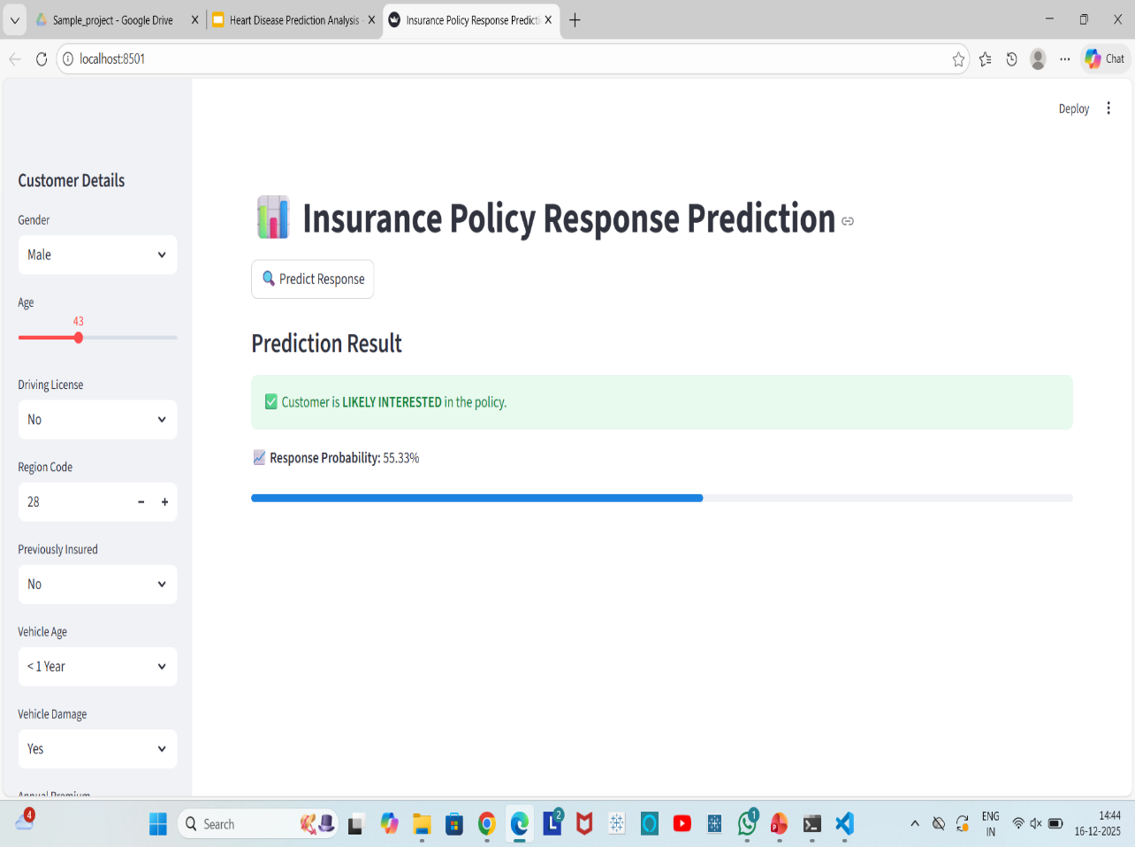
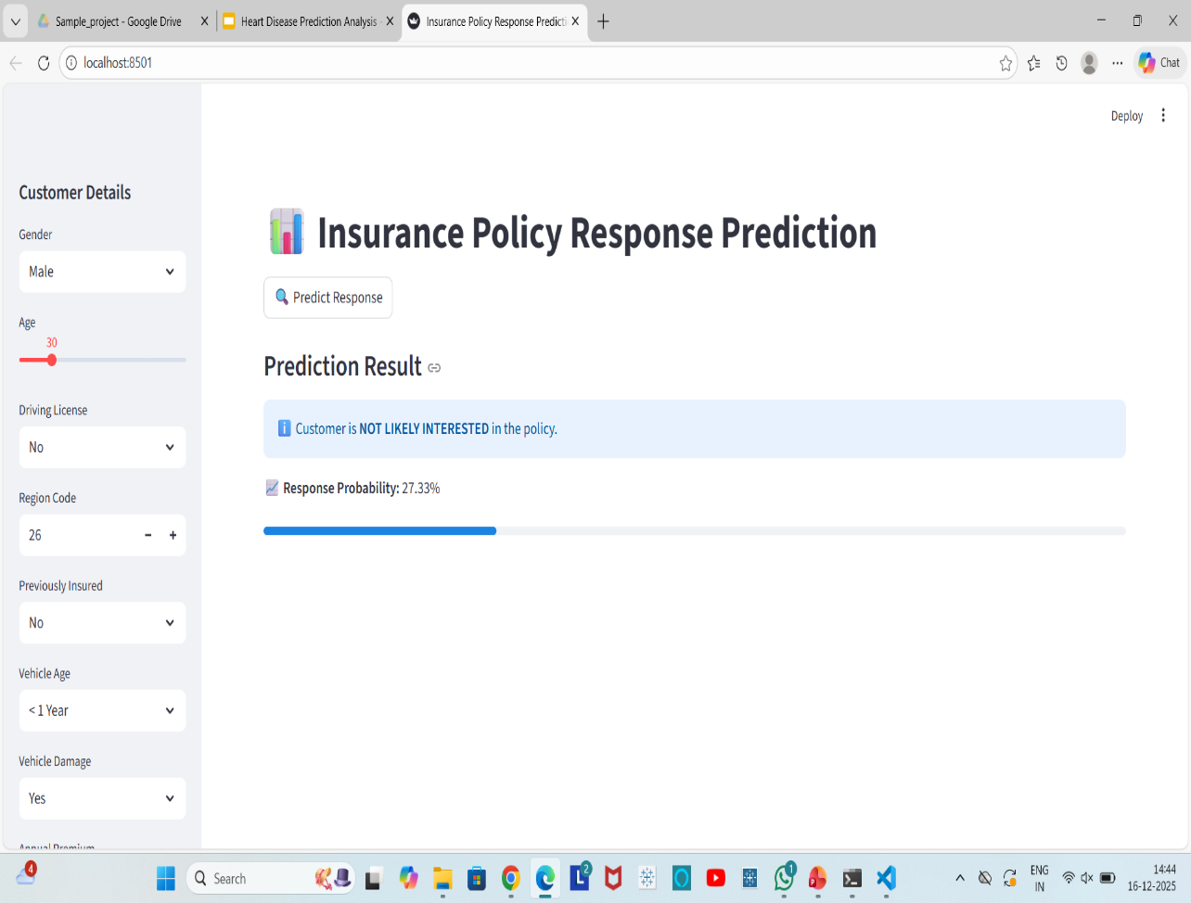
Streamlit UI

Slide 20
Conclusion
KEY FINDINGS
Best Performing Model
Tuned Random Forest Classifier
Outperformed Logistic Regression and Decision Tree models.
Why Random Forest Performed Best
Strong balance of Accuracy, Precision, Recall, and F1-Score
Handles non-linear relationships effectively
Robust against overfitting after tuning
Business Impact
Enables targeted marketing instead of mass campaigns
Reduces marketing cost and resource wastage
Improves policy conversion rate
Supports data-driven decision making in insurance sales
The tuned Random Forest model is the most effective approach for predicting customer response to insurance policy offers. It provides actionable insights that help insurance companies prioritize high-potential customers and optimize marketing strategies.

Slide 21
Future Scope
Implement advanced models like XGBoost and LightGBM to improve prediction performance.
Apply class imbalance techniques (SMOTE) to enhance recall for minority responses.
Perform advanced feature engineering using customer behavior and interaction features.
Integrate the model with real-time insurance databases / CRM systems.
Add model explainability (SHAP/LIME) for transparent business decisions.
Deploy the application on cloud platforms for scalability and wider access.

Slide 22
Thank You!

